Slide 1
SHINC – SHEK ETC
These actually change the dates and calculate the laytime hours

Slide 2
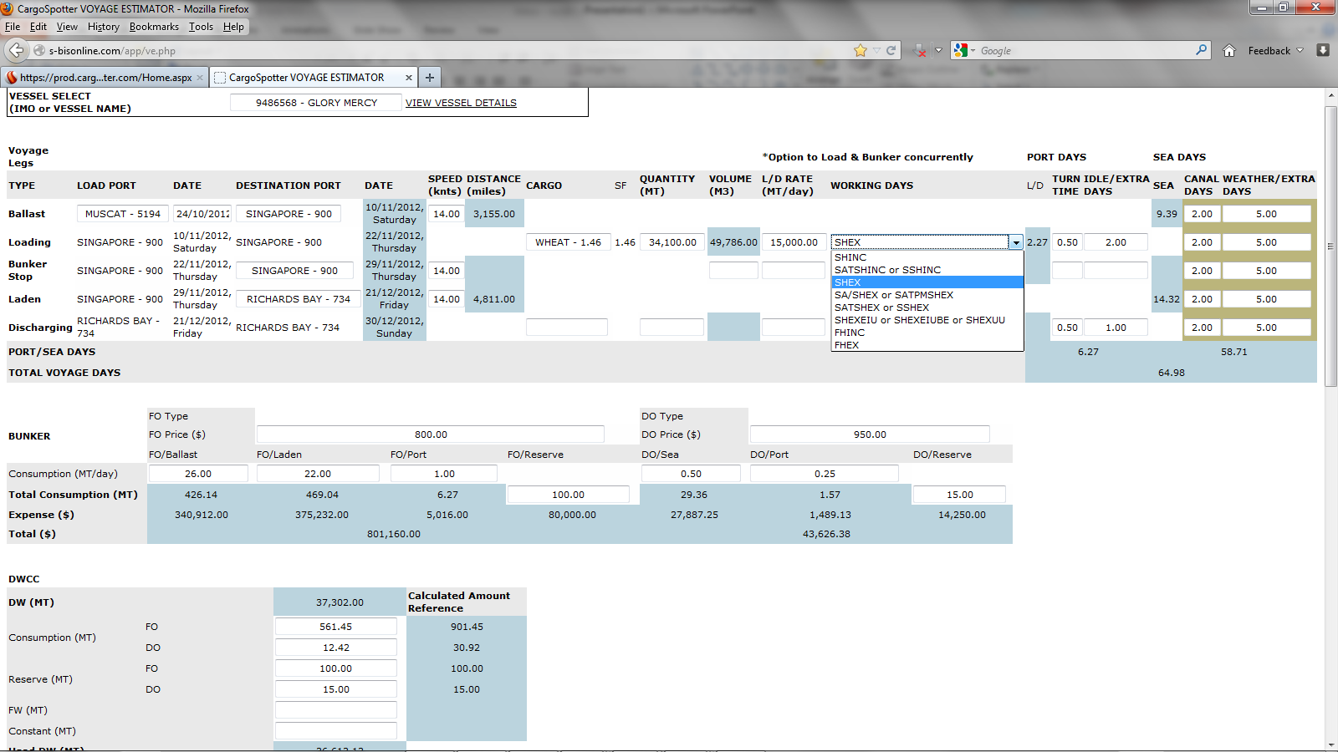

Slide 3
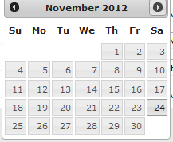
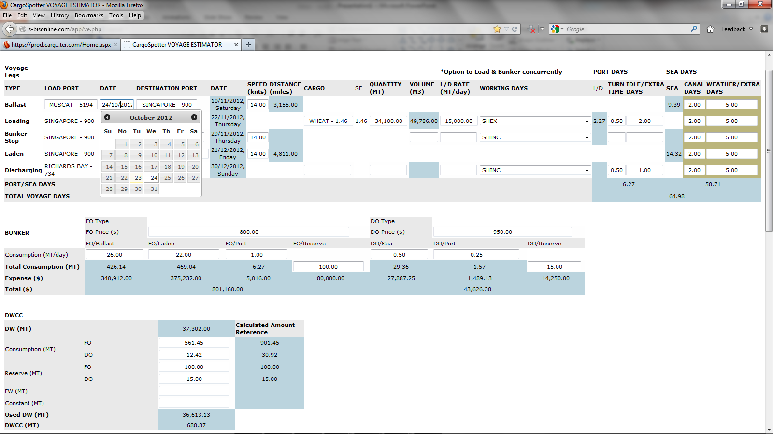
So arrives on 22/11 and will take 2.27 days PLUS IDLE or extra Days. So The TURN TIME should reflect any extra days reflected. We cannot account for HOLIDAYS as that is too much. BUT we can have a note that Holidays are not included.
The 2.27 days plus IDLE or EXTRA DAYS should be converted to hours and added to LAYTIME hours on next slide. EDITABLE in case you want to change.
Working Days
SHINC | sun, holiday included
SATSHINC or SSHINC | sat, sun, holiday included.
SHEX | sun, holiday excluded
SA/SHEX or SATPMSHEX | sat after 12pm, sun, holiday excluded
SATSHEX or SSHEX | sat, sun, holiday excluded.
SHEXEIU or SHEXEIUBE or SHEXUU | sun, holiday excluded even if used both ends
FHINC | fri, holiday included
FHEX | fri, holiday excluded
Working Days
SHINC | sun, holiday included
SATSHINC or SSHINC | sat, sun, holiday included.
SHEX | sun, holiday excluded
SA/SHEX or SATPMSHEX | sat after 12pm, sun, holiday excluded
SATSHEX or SSHEX | sat, sun, holiday excluded.
SHEXEIU or SHEXEIUBE or SHEXUU | sun, holiday excluded even if used both ends
FHINC | fri, holiday included
FHEX | fri, holiday excluded

Slide 4
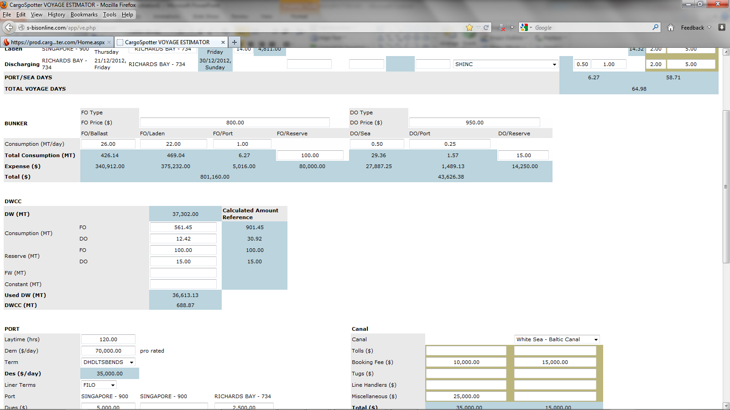
So arrives on 22/11 and will take 2.27 days PLUS IDLE or extra Days. So The TURN TIME should reflect any extra days reflected. We cannot account for HOLIDAYS as that is too much. BUT we can have a note that Holidays are not included.
The 2.27 days plus IDLE or EXTRA DAYS should be converted to hours and added to LAYTIME hours on next slide. EDITABLE in case you want to change.

